Slide 1
KEYWORDS
Simultaneous
Intercept
Gradient
y=mx+c

Slide 2
Identify the gradient and y intercept in a function
Remember:
y = mx + c
m is the gradient, or the slope of the graph
c is the y-intercept, or where the graph cuts the y-axis

Slide 3
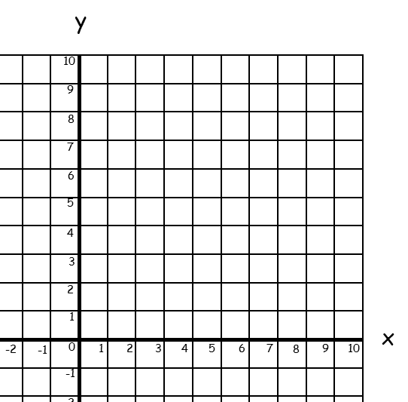
Simultaneous Equations Graphically
Solve the simultaneous equations y = 2x + 1 and y = 3 graphically:
Start by sketching y = 2x + 1
Start at 1 on the y-axis.
For every 1 across, go up 2.
Join with a straight line.

Slide 4
Simultaneous Equations Graphically
Solve the simultaneous equations y = 2x + 1 and y = 3 graphically:
Now sketch y = 3.
This means that for every value of x, y = 3.
Find 3 on the y axis and draw a horizontal line through it.

Slide 5
Simultaneous Equations Graphically
Solve the simultaneous equations y = 2x + 1 and y = 3 graphically:
The solution is the coordinate where the graphs cross.
(1, 3)
So x = 1 and y = 3.

Slide 6
Simultaneous Equations Graphically
Solve the simultaneous equations y = 3x + 2 and y = 6 – x graphically:
Start by sketching y = 3x + 2
Start at 2 on the y-axis.
For every 1 across, go up 3.
Join with a straight line.

Slide 7
Simultaneous Equations Graphically
Solve the simultaneous equations y = 3x + 2 and y = 6 – x graphically:
Now sketch y = 6 – x.
Start at 6 on the y-axis.
For every 1 across, go down 1.
Join with a straight line.

Slide 8
Simultaneous Equations Graphically
Solve the simultaneous equations y = 3x + 2 and y = 6 – x graphically:
The solution is the coordinate where the graphs cross.
(1, 5)
So x = 1 and y = 5.

Slide 9
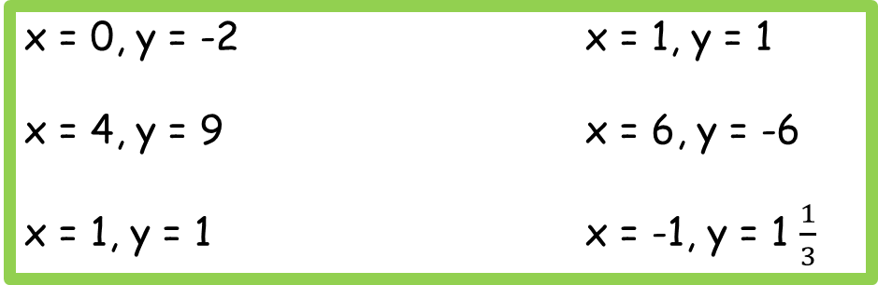
Simultaneous Equations Graphically
Answers
x = 4, y = 8 x = -2, y = -6
x = 1, y = 3 x = 4, y = 0
x = 2, y = 1 x = 1, y = 4
x = 0, y = -2 x = 1, y = 1
x = 4, y = 9 x = 6, y = -6
x = 1, y = 1 x = -1, y = 1 $\frac{1}{3}$

Slide 10
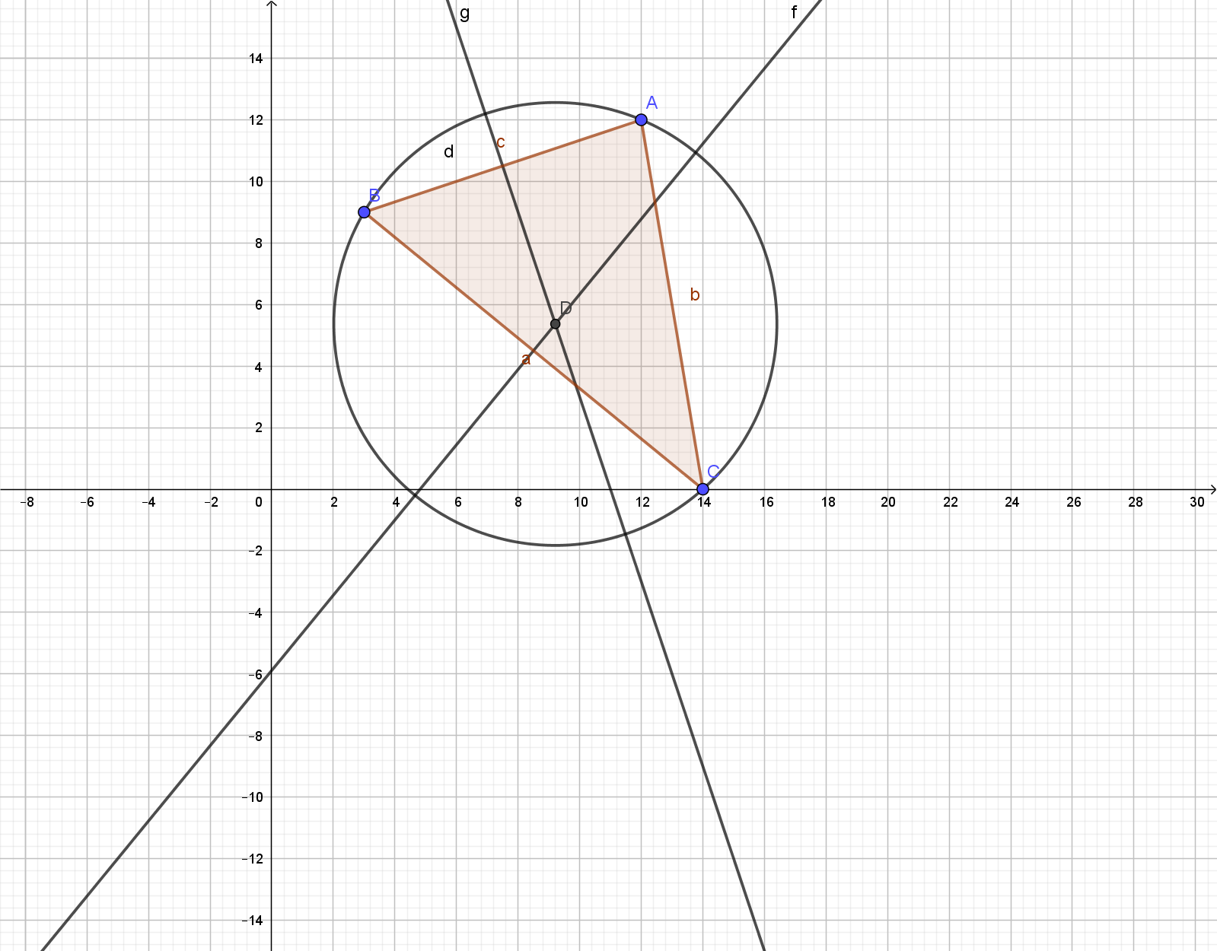
Simultaneous Equations Graphically
Answers
Centre point is (9.21, 5.37)
Point A is at (12,12)
Radius AD is 7.193122 cm
Area = 162.5491455 cm²

Slide 11
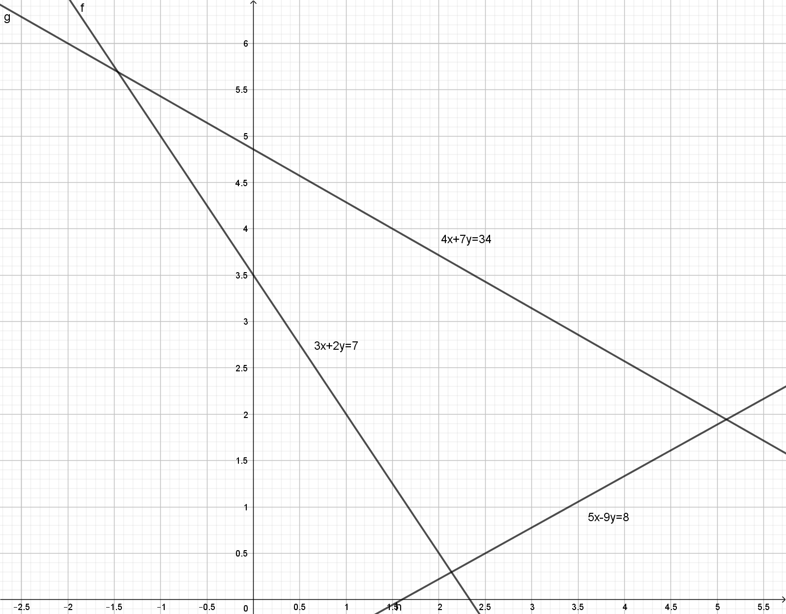
Simultaneous Equations Graphically
Answers
Centre point is (9.21, 5.37)
Point A is at (-1.46, 5.69)
Point B is at (5.1, 1.94)
Point C is at (2.14, 0.3)

